Slide 1
RuckU 2013 on Tour
GT Hill & Eric Stresen-Reuter

Slide 2
Housekeeping
Restrooms
Agenda
Tweet!
  #rucku
  @ericsr @gthill @ruckuswireless
Introductions

Slide 3



Ruckus in 15
Company, Technology, and Update

Slide 4
Fast and Fierce
CARRIER
30%
2012
Began Operations | 2004, Sunnyvale, CA
Status | Publicly held (NYSE: RKUS)
CEO | Selina Lo
Innovation | Carrier class Smart Wi-Fi
R&D Centers | Sunnyvale, China, Taiwan, India, Israel
2011/2012 Revenue | $120 million / $214.7 million (79% y/y)
4Q12 revenue | $62.2 million
CAGR | 64% (2009-2011)
Customers | 20,000+
Employees | 725+ in 33 countries
Patents | 60 granted (82 pending)
Markets | Carrier/enterprise wireless infrastructure
REVENUE
70%
ENTERPRISE

Slide 5


Growing Share in the Enterprise
World’s Top Three WLAN Suppliers (4Q12)
(based on estimated revenue)
65%
Others
Cisco
Worldwide WLAN Market Growth
(1Q11 to 4Q12)
33%
51%
11%
5%
Aruba
34%
33%
20%
Aruba
Cisco
Ruckus

Slide 6
Outpacing the WLAN Market
Quarterly Enterprise WLAN
Market Growth from 1Q11 to 4Q12
(based on estimated revenue)
SOURCE:
VENDOR | Q1 2011 | Q2 2011 | Q3 2011 | Q4 2011 | Q1 2012 | Q2 2012 | Q3 2012 | Q4 2012 | % Change 1Q11-4Q12 | CQGR*
Cisco | 321.9 | 360 | 399.2 | 417.7 | 407.6 | 491.7 | 502.4 | 557.1 | 33% | 8.1%
Aruba | 77.9 | 79.1 | 79 | 93.7 | 105.5 | 110.5 | 114.6 | 123.3 | 20% | 6.7%
RUCKUS | 18.5 | 22.8 | 29.6 | 40.4 | 43 | 45.7 | 52.4 | 56.0 | 65% | 17.4%
TOTAL MARKET | 617 | 649 | 796 | 798 | 801 | 952 | 1012 | 1090 | 34% | 8.4%
Aruba
Cisco
*Compound quarterly growth rate

Slide 7

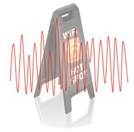


More is Killing Wi-Fi
Industry Challenges!
1
Interference
MORE
HOTSPOTS
Dropped packets, low data rates
MORE
USERS
MORE
TRAFFIC
2
MORE
APPLICATIONS
MORE
VIDEO
Capacity Constraints
MORE
DEVICES
MORE
NOISE
Dealing with mobile device capacity and management
3
Flexibility and Scale
Product and management solutions for any network

Slide 8
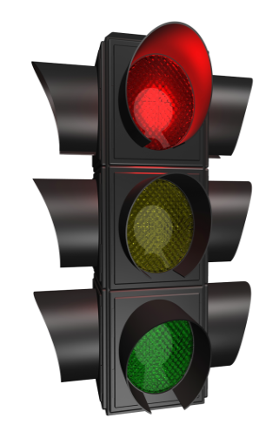
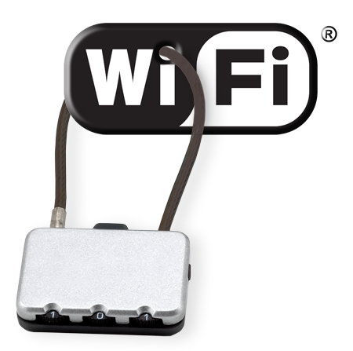
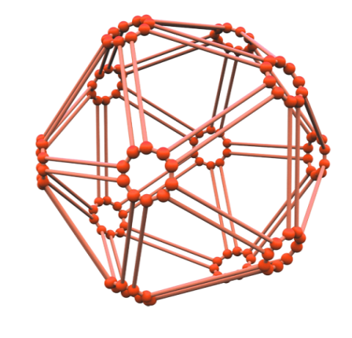
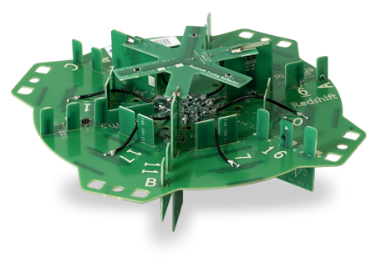
Technology Breakthroughs
ADAPTIVE
ANTENNAS
SMARTCAST
MESHING
SECURITY
QoS
ChannelFly
SmartRoam
Airtime Fairness
Band-Steering
Self-provisioning
self-optimizing
high speed
wireless backbone
Advanced
per-user
security
Adaptive
antenna
technology

Slide 9
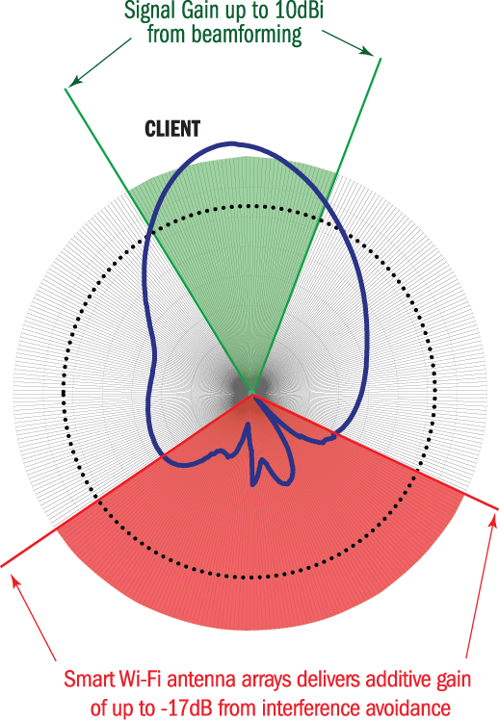
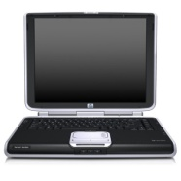

Automatic Interference Mitigation
Minimizes Packet Loss and Re-Transmissions, Increases Reliability
Interference mitigated by positioning antenna nulls in specific directions
Avoiding interference delivers more benefits than a stronger signal
  Better throughput
  More predictable connectivity
AP

Slide 10
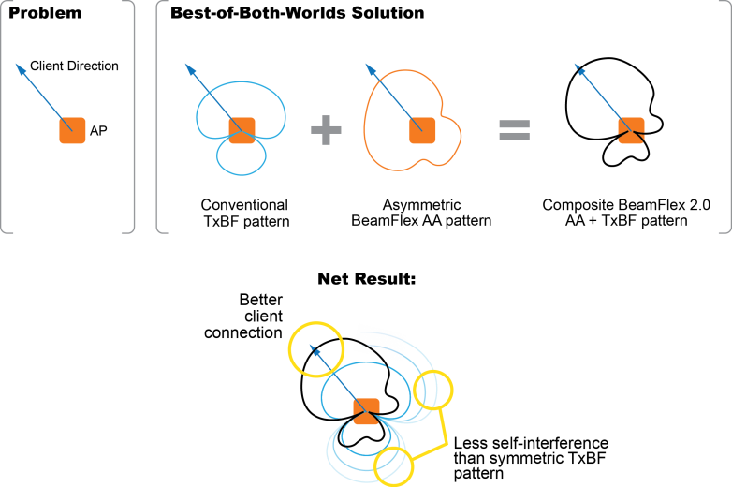
Transmit Beamforming
Adaptive Antennas and Transmit Beamforming Working Together
6dB
9dB
3dB
15dB OF
9dB OF
>
>
INTEFERENCE
MITIGATION
SIGNAL TO INTEFERENCE
PLUS NOISE (SINR)
IMPROVEMENT

Slide 11

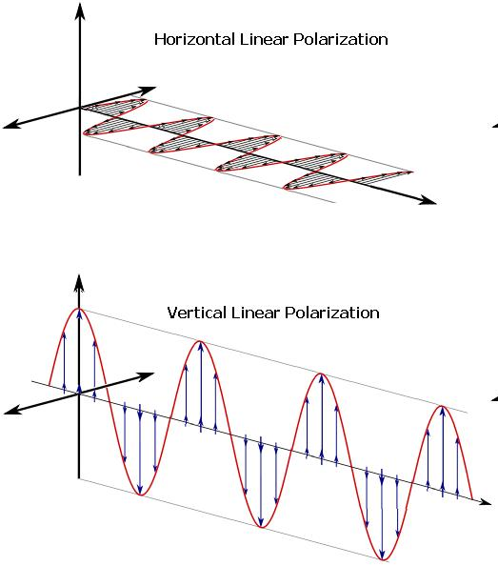
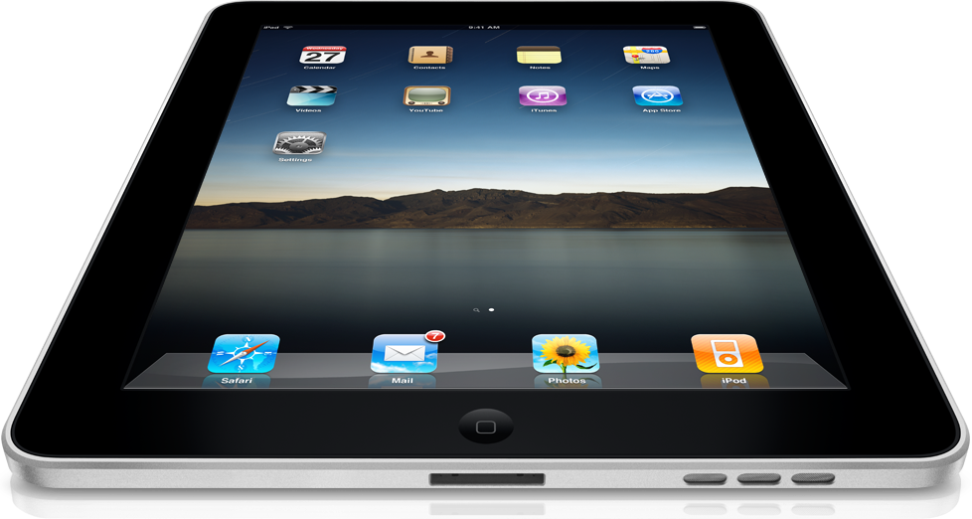
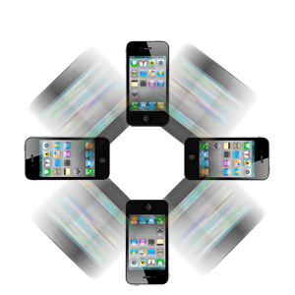
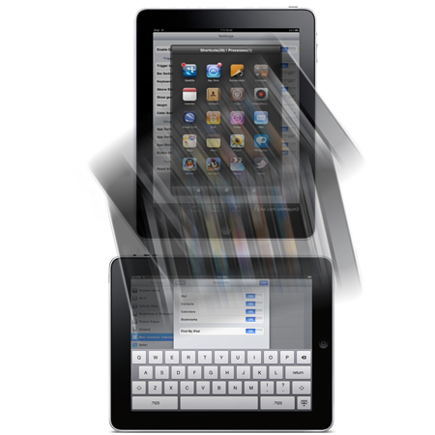
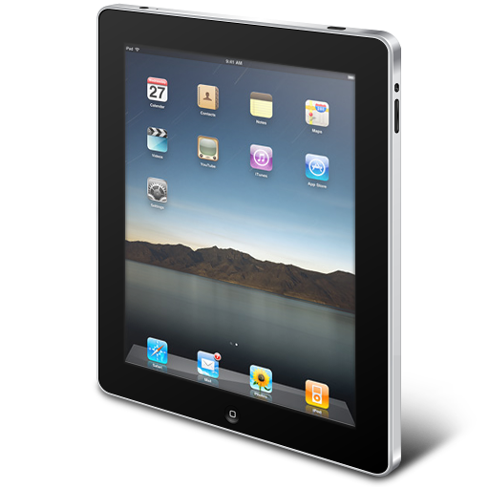
BeamFlex+
5x
Better reception (PD-MRC) for weak and hard to “hear” devices
Better transmission to devices constantly changing their orientation
Device orientation accounts for up to 5x performance differential among products
HORIZONTAL
POLARIZATION
VERTICAL
POLARIZATION
Notes:
Improved

Slide 12
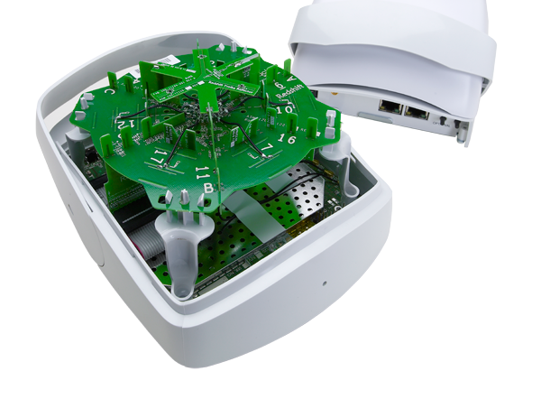



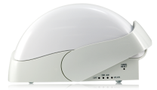
Real-Time Adaptation
Interference
Patented technology that combines:
  Smart antenna arrays
  Best path selection algorithms
  Advanced quality of service engine
  Smart mesh RF routing
  Centralized Wi-Fi management
Adapts to real-time changes
in environmental conditions
Extends signal range (Wi-Fi coverage)
2 to 4 times with fewer APs
Radically simplifies deployment
and administration

Slide 13


ChannelFly
Predictive channel system
Maintains maximum network throughput
Quickly avoids interference from congested and noisy environments
Feature Summary
Continuously learns network capacity to evolve channel decision intelligence
Evaluates all channels, not just 1/6/11, by using them – no background scanning or guessing required
Fast reaction (in seconds) to significant drop in throughput
Wi-Fi Client friendly using 802.11h
Supports 2.4 GHz, 5 GHz and Mesh
Channel | 1 | 2 | 3 | 4 | 5
Observed throughput | 80 | 24 | 160 | 30 | 12
…
…
1
2
5
4
3

Slide 14
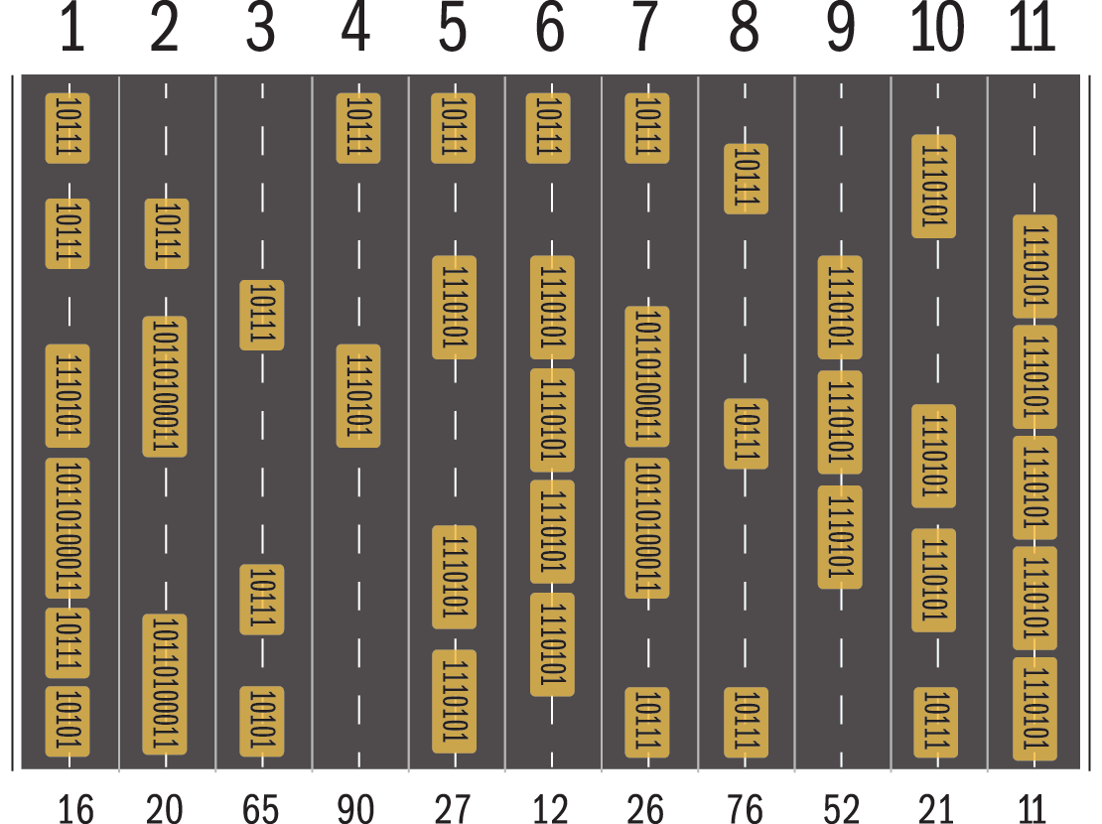
It’s All About Channel Capacity
2.4GHz RF CHANNEL
500
Competing approaches:
Go off channel
to listen only
Listen for beacons, frame errors, RF interference
Take a very small snapshot in time
Don’t provide a complete view of the entire spectrum
TIME
(miscroseconds)
0
OBSERVED THROUGHPUT (Mbps)

Slide 15

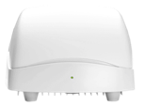
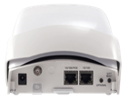




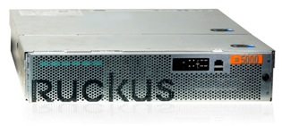
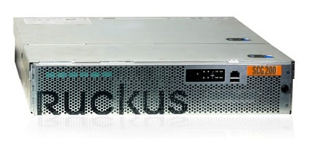
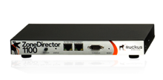
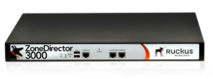
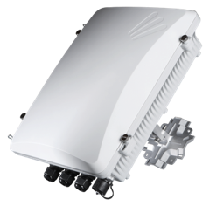
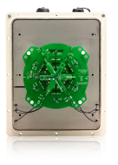
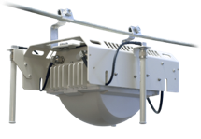

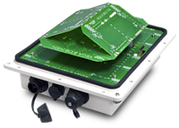
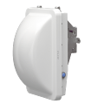
Extensive Smart Wi-Fi Portfolio
INDOOR
HIGH END
MIDRANGE
LOW END
3X3, 3-stream
dual-band 802.11n
Enterprise
dual-band
Mid-range
dual band
Entry level
802.11n
Entry-level
802.11g
Wi-Fi
wall switch
MANAGEMENT
6 to 50 Aps
SME
50 to 500 APs
Mid-range
50 to 1000 APs
High end
Up to 10K APs
SP Gateway platform
OUTDOOR
Small cell + Wi-Fi
Strand mount
802.11n
Dual-band
AC powered
Dual-band
802.11n
Dual-band
sectorized
Point to point and
multipoint bridges

Slide 16

Questions

Slide 17
Wi-Fi – Past Present and Future

Slide 18
Past and Present...
Whiteboard session

Slide 19
Ruckus on 802.11ac

Slide 20
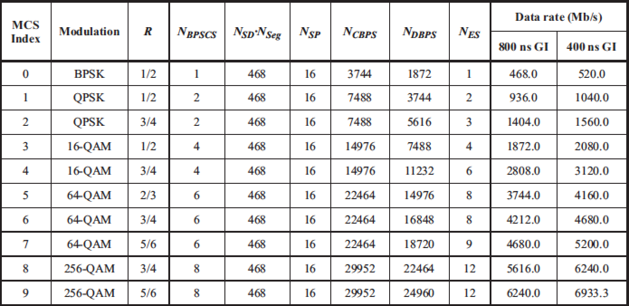
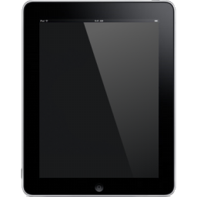
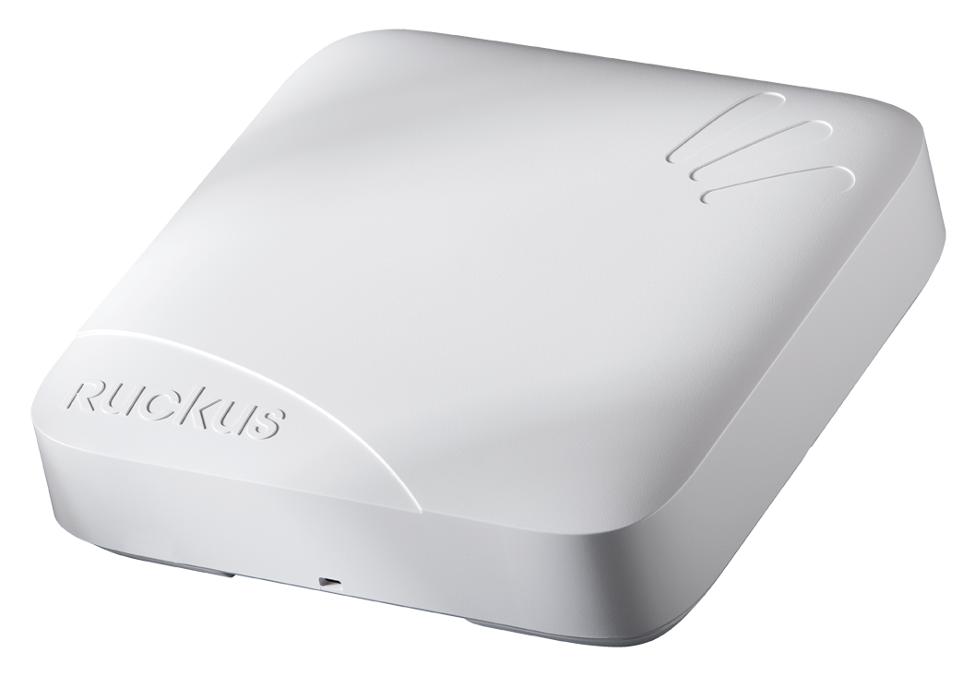
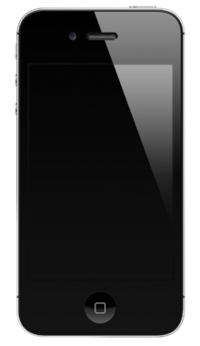
An Overview
Optimistic Specs
5 GHz Only
5G
80/160 MHz channels
20
40
2.4G
80
160
Breaks “gigabit” barrier
Max of 6.9 Gbps
“Gimmick” specs that drive data rates very high
Many features not practical for real-world enterprises
Encourages 5G adoption
Focuses on capacity-rich, low-interference spectrum
Benefits entire Wi-Fi ecosystem
Very wide channels
Primary reason for 11ac’s very high data rates
Ineffective use of spectrum in multi-AP environments
Decreases total capacity
Up to 8 spatial streams
AP
256-QAM
Multi-user MIMO (MU-MIMO)
N-fold efficiency improvement
Increases radio complexity, power draw, and cost
Requires client-side support
Not possible today
More efficient modulation
33% data rate gains
Very short ranges only
Requires 11ac clients
Simultaneous downlink Tx to single-stream clients
Multiples network capacity
Key differentiator from 802.11n
RUCKUS WIRELESS PROPRIETARY AND CONFIDENTIAL

Slide 21
5 GHz Only
11ac supports 5 GHz frequencies only
  Dual-band devices will support 11n in 2.4 GHz
Focuses on spectrum with more bandwidth, less interference, and better scalability and capacity
Encourages client device suppliers to adopt 5 GHz, to benefit from 11ac marketing, leaving 2.4 GHz as “best effort” spectrum
480 MHz
25 channels
Capacity
83.5 MHz
3 channels
2.4G
5G

Slide 22
80 and 160 MHz Channels
OVERVIEW
Pros
11ac devices must support 80 MHz channel width
Optional support for 160 MHz
  Contiguous or non-contiguous (80+80)
Boosts maximum 802.11ac specs
Appeal is for consumers with 1 AP
Max data rate is more than doubled
Boosts throughput in networks with few APs
Improves backup, file transfer speeds
Cons
Sub-optimal spectral reuse in multi-AP deployments
Max of 5 non-overlapping 80 MHz channels
Increases neighbor interference and contention
Likely decreases aggregate capacity in enterprise
5170 MHz
5330 MHz
5490 MHz
5730 MHz
5735 MHz
5835 MHz
UNII-1
UNII-2
100
104
108
112
UNII-2e
UNII-3/ISM
Total
36
40
44
48
52
56
60
64
116
120
124
128
132
136
140
144
149
153
157
161
165
802.11a/b/g
20 MHz
9
25
802.11n
40 MHz
38
46
54
62
102
110
118
126
134
142
151
159
12
4
42
58
106
122
138
155
6
80 MHz
2
160 MHz
50
114
0
802.11ac
2
160 MHz (80+80)
2
1
DFS
Red channels are not permitted in some regions
Notes:
New Channel Terminology:
20 MHz - 36, 40, 44, 48, 52, 56, 60, 64, 100, 104, 108, 112, 116,120, 124, 128, 132, 136, 140, 144, 149, 153, 161, 165, 169
40 MHz - 38, 46, 54, 62, 102, 110, 118, 126, 134,142, 151, 159
80 MHz - 42, 58, 106, 122, 138, 155
160 MHz - 50, 114

Slide 23
Dynamic Bandwidth Operation
Wider channels (80 / 160) have “primary” subchannels (20 / 40 / 80)
Devices can dynamically use smaller or larger bandwidths according to interference (Wi-Fi or non-Wi-Fi) in the larger portions of the band
UNII-1
UNII-2
36
40
44
48
52
56
60
64
20
20
20
20
20
20
20
20
40
40
40
40
80
80
160
Primary subchannels (20, 40, 80) are used dynamically if larger channel is “busy”
48
48
44
44
80
80
40
20
40
40
40
36
20
20
36
AP1: 802.11ac
Primary(20): 36
Primary(40): 38
AP2: 802.11ac
Primary(20): 48
Primary(40): 46
AP3: 802.11n
Channel(20): 40
TIME

Slide 24
Spatial Streams
802.11ac defines up to 8 spatial streams
802.11n defined up to 4 spatial streams
Flagship devices today support up to 3SS
Enterprises often prefer cost/performance of 2x2 APs
Real-World Barriers
Bandwidth | 1ss | 2ss | 3ss | 4ss | … | 8ss
20 MHz | 78 | 156 | 260* | 312 | … | 624
40 MHz | 180 | 360 | 540 | 720 | … | 1440
80 MHz | 390 | 780 | 1170 | 1560 | … | 3120
  Business
    Increases AP/client cost
    Increases AP/client size
    Decreases aesthetic appeal
    2x2 APs often meet the business need
  Technical
    Short range for 4+ streams
    More streams require RF “differentiation” (difficult with 4+ streams)
    Adds power draw on APs (PoE power budget) and clients (battery life)
256-QAM, 800 ns GI
Artificially bloats max data rates of 802.11ac
8x8:8 (MIMO)
8x8:8 (MIMO)

Slide 25
256-QAM
100% gain (2x)
256-QAM improves efficiency by 33%
Higher-order modulation adds complexity, which requires higher SNR
  Beneficial near the AP
Efficiency gain from modulation does not increase linearly
Requires 802.11ac AP and client
BPSK
QPSK
01
11
0
1
00
10
100% gain (2x)
50% gain (1.5x)
33% gain (1.3x)
16-QAM
64-QAM
256-QAM

Slide 26
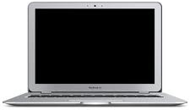
Multi-User MIMO (MU-MIMO)
Transmit simultaneous downlink frames to different receivers
Significant capacity enhancements in environments with many single-stream devices (tablets, smartphones)
Requires 11ac client(s) with TxBF feedback/support
Creates new challenges related to signal steering and isolation
  How to get…
DataA to StaA
DataB to StaB
No DataA to StaB
No DataB to StaA
Single-User MIMO
Single downlink Tx at a time
Multi-User MIMO
Multiple downlink Tx at same time
4x4:4
Access Point
4x4:4
Access Point
Stream 1
Stream 1
Stream 2
Stream 3
Stream 4

Slide 27
Large(r) Frame Size
Why throughput does not equal data rate…
Overhead
Effective
Overhead
11a/g
Interframe Space
Random
Backoff
PHY Header
MAC Header
Payload
Interframe Space
ACK
Overhead
Effective
Overhead
11n
Interframe Space
Random
Backoff
PHY Header
MAC Header
Payload
Interframe Space
ACK
Overhead
Effective
Overhead
11ac
Interframe Space
Random
Backoff
PHY Header
MAC Header
Payload
Interframe Space
ACK
Time
*Note: Diagrams are not to scale and are conceptual only
PHY | Aggregation | Max Bytes (Layer 2) | Max Bytes (Layer 1)
11b | N (fragmentation often used) | 2,304 | ~2,336
11a/g | N | 2,304 | ~2,336
11n | Y | 7,935 | 65,535
11ac | Y | 11,454 | 1,048,575
The Solution: increase payload size
  Every data frame in 802.11ac is an A-MPDU
  Better spectrum efficiency enables larger frame sizes without adverse impact from interference
  Use of large frames depends on high rates

Slide 28
FAQ
Q:
Is it backward compatible with 11a/n?
Yes. 11ac is fully backward compatible with 802.11a/n, using protection mechanisms with 11a/n frame formats.
What about 2.4 GHz?
Initially, dual-band APs will be 802.11n in 2.4G and 802.11ac in 5G. 11ac may eventually be retrofitted to 2.4G for benefits from added spatial streams or 256-QAM.
Will it require new hardware?
Yes. For every supplier, all APs and clients will need new hardware, whether complete AP replacement or modular radio add-ons. Controllers or management software may be software upgradeable.
A:
Q:
A:
Q:
A:

Slide 29
11ac in Waves
Wave 1 – Q3, 2013
256-QAM | 33% gain at very short range
80 MHz channels | Twice the capacity of 40 MHz 802.11n (but not recommended for multi-AP deployments)
3 spatial streams | Already supported by 802.11n (3x3)
Net gain
  Slight efficiency improvement, most benefits are for 802.11ac devices
Wave 2 – Late 2014
Wave 1+ | Includes all Wave 1 features, with additional chip improvements
80 / 160 MHz channels | Twice the capacity of 80 MHz 802.11ac (but not recommended for multi-AP deployments)
3+ spatial streams | Likely 4 spatial streams. N-fold throughput gain for high-end clients, more flexibility/capacity for MU-MIMO
MU-MIMO | Up to 4x capacity boost, multiplies aggregate capacity
Net gain
  Multiples aggregate network capacity and efficiency, ALL devices benefit

Slide 30
Better 11ac with Ruckus
Making the most of next-generation Wi-Fi
RUCKUS WIRELESS PROPRIETARY AND CONFIDENTIAL

Slide 31
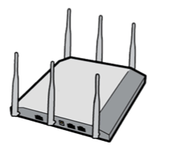

Maximizing 256-QAM
Them
BPSK
Us
DPSK
16-QAM
64-QAM
256-QAM
With per-packet adaptive antenna control, polarization diversity, and active channel selection techniques, Ruckus APs maximize the potential of 256-QAM with 11ac
  Greater SNR/SINR increases the useful downlink range of 256-QAM
  Adaptive PD-MRC and higher uplink receive sensitivity increase uplink range of 256-QAM
  APs select channels with more capacity and less noise and interference

Slide 32
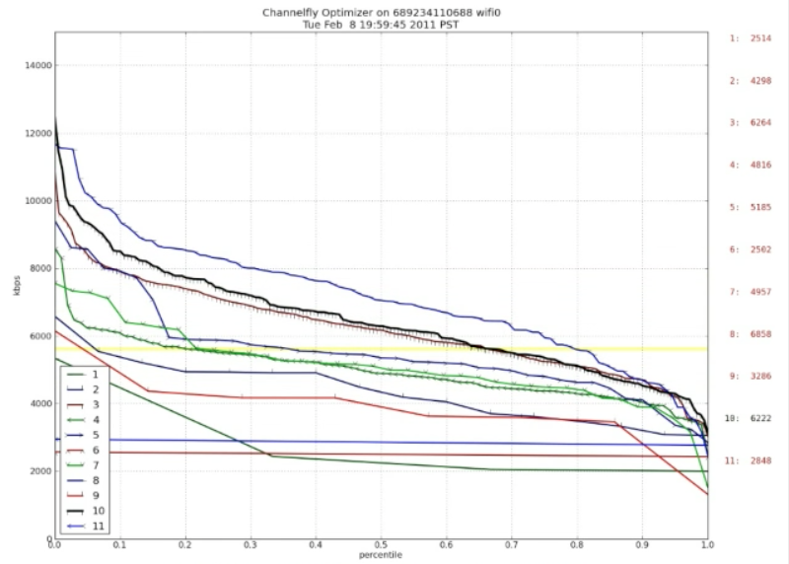
Smarter Channel Planning
CHANNEL PLANNING
36
40
44
48
52
56
60
64
802.11ac introduces the possibility of 20 MHz, 40 MHz, 80 MHz, or 160 MHz channels
Each 40, 80, or 160 MHz channel will have primary 20, 40, and 80 MHz channels
It becomes increasingly difficult to determine what channel widths are optimal for each environment based on spectral reuse, the number of APs, transmit power, client device types and channel support, etc.
Manual channel planning becomes VERY DIFFICULT
38
46
54
62
42
58
50
DYNAMIC OPERATION
The dynamic nature of RF environments raises new concerns for both ongoing channel width settings (should we use 20s, 40s, 80s?) as well as AP channel assignment adaptation (what primary 20/40/80 channels should I use at any moment in time?)
APs must be able to select the best primary 20, 40, and 80 MHz channels for their own environment, or possibly change from 80 MHz operation to 40 MHz.
48
44
40
36
TIME
CHANNELFLY
ChannelFly will tackle both problems (channel width and channel assignment) by…
  Actively measuring performance on each channel
  Adaptively changing as environmental conditions fluctuate
  Discovering the best channel settings for the environment, the client device types, count, and channel width support, and the amount of traffic at each bandwidth setting

Slide 33

BeamFlex-Enhanced MU-MIMO
3x3 MU-MIMO
3 clients concurrently communicate with AP, each on a dedicated spatial stream (and antenna)
Antenna 1 to Client 1
Antenna 2 to Client 2
Antenna 3 to Client 3
AP
Standard MU-MIMO
All clients hear all antennas
Poor signal isolation per client
Lower SNR per link = lower data rates
Marginal benefit to capacity
MU-MIMO enhanced with BeamFlex
Directional antenna element for each client
Better signal separation
Higher sustained data rates
Increased AP capacity
Notes:
Each antenna achieves directivity adapted individual clients, so each client hears its dedicated antenna best

Slide 34
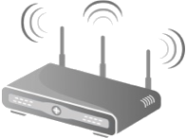




11w Overview
Ratified by IEEE in 2009 (802.11w-2009)
Introduced by Wi-Fi Alliance as Protected Management Frames (PMF) certification
PRIOR TO 802.11w
WITH 802.11w
OK
Invalid. Disregard.
OK
Invalid. Disregard.
✔
✔
Deauth / Disassoc.
Deauth / Disassoc.
VALID USERS
VALID USERS
HACKER
OK
HACKER
Invalid. Disregard.

Slide 35
Frame Types w/o 11w - Primer
802.11 FRAME TYPES
PROTECTED
Beacons, Probes, (De)Authentication, (Dis/Re)Association, Action
No encryption, data origin authentication, or replay protection
Easily spoofed, enabling hijacking, DoS, and many other attacks
Mgmt
RTS, CTS, ACK, PS-Poll
No encryption, data origin authentication, or replay protection
No protection needed
Control
Data, Null Data, QoS Data
Provides encryption, data origin authentication, and replay protection
Unicast protection uses individual PTK
Group (BC/MC) uses shared GTK
✔
Data
Traditionally, only data frames are encrypted and integrity-protected (source validation)
Management frames are increasingly important to network operation
802.11w provides for data integrity, replay protection, and origin authenticity of some management frames
  Robust Management frames – Disassociation, Deauthentication, and Robust Action frames

Slide 36
How it works
Security keys are negotiated at association
  If PMF is supported, unicast frames (data and mgmt) are protected with CCMP/AES
  Group protected management frames rely on Broadcast/Multicast Integrity Protocol (BIP), which also use
11w provides data integrity and replay protection for robust management frames
Detects whether received frame is an unauthorized retransmission
Type | Unicast | BC/MC
Data | TKIP/CCMP (PTK) | TKIP/CCMP (GTK)
Control | None | None
Mgmt | None | None
Robust mgmt | CCMP (PTK) | BIP (IGTK)
11w Protected Frames
802.11 header
Management Frame Body
MMIE
FCS
ADDED IN 11W
Management MIC IE (MMIE) contents
  KeyID – Identifies the IGTK (unique to sender) used to compute MIC
  IGTK Packet Number – Sequence counter used for replay protection
  MIC – Message Integrity Code calculated over frame body

Slide 37
Limitations
Robust management frames are NOT encrypted
  They are still sent “in the clear”
Does not provide data origin authenticity (can I confirm who sent this?) to bc/mc frames (data and mgmt – fault of symmetric encryption)
Does not help clients that do not support 11w – they still need traditional unprotected management frames
  PMF can be “mandatory” or “supported”
  If “supported,” only clients with 11w support have protection
PMF “SUPPORTED”
Invalid. Disregard.
Invalid. Disregard.
✔
Deauth / Disassoc.
VALID USER WITH 802.11w
HACKER
OK
VALID USER NO 802.11w

Slide 38
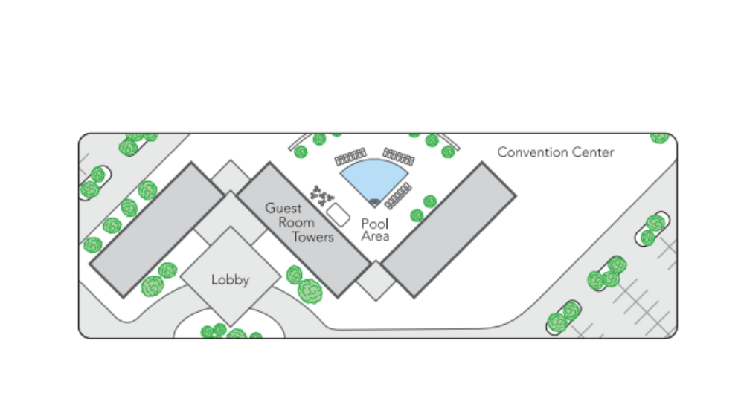









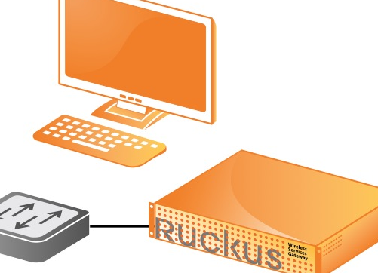







HotSpot 2.0 and the Enterprise
HS2.0
SSID
Hotel
SSID
Provider leverages hotel infrastructure for data offload/extended service footprint
Provider increases visibility and stickiness to subscriber (loyalty)
Provider SSID enabled on any/all APs
Provider SSID tunneled to 3G/4G core (transparent authentication, policy, etc.)
Hotelier enables Wi-Fi mobility for dual-mode handsets
Hotelier adds incremental revenue at no cost
Secure tunnel
to provider NOC/DC
3G/4G
Cores
INTERNET
Offload directly
to Internet
PROVIDER
DATA CENTER

Slide 39
Questions
Break

Slide 40
High Density Wi-Fi
Design and Technology

Slide 41
High Density Defined
A high density deployment generally has:
  More than 3 APs required to support SLA
  Very few physical obstructions
  High number of concurrent users

Slide 42
High Density Challenges
The Unbounded Medium
Number of devices per channel
Number of available channels
Co-channel interference

Slide 43


Co-Channel Interference
Notes:
43

Slide 44
Co-Channel Interference
*Circles represent > -95 dBm
*Circle represents > -70 dBm
Notes:
44

Slide 45
Somewhat Bold Statements
The more obstructions, the better
Extra signal from adaptive antennas isn’t as advantageous as usual
Hope that the customer wants a lot of downstream traffic

Slide 46
The More Obstructions is Better
High density areas are prone to
co-channel interference
Obstructions attenuate RF energy and significantly reduces co-channel interference

Slide 47
Extra Signal From Adaptive Antennas Isn’t as Helpful
Excess signal actually creates more problems than it solves in HD scenarios.
Most vendors control their signal by reducing transmit power
However, control of the signal is key.
  Adaptive antenna array sends the signal only where it needs to go

Slide 48

Co-Channel Interference reduction with BeamFlex
Ch 1
Ch 6
Ch 11
Notes:
48

Slide 49
Hope That The Customer Wants A Lot Of Downstream Traffic
Downstream traffic is only sent by the AP
Upstream traffic is sent by everyone else
  The more devices that transmit, the higher the chance of collision

Slide 50
Data rate, Signal and Capacity
Higher signal equals higher data rate
Higher data rate equal higher capacity
Example RSSI Chart
  180 Mbps = -82 dBm
  240 Mbps = -78 dBm
  270 Mbps = -76 dBm
  300 Mbps = -74 dBm
Channel Capacity Improvement
  + 8dB = 50.3%
  + 4dB = 18.5%
  + 2dB = 8.2%

Slide 51
Airtime Fairness
The Problem
  Diversity of clients
    Slow vs. fast clients
    11b vs. 11a/g vs. 11n
  Slower clients take more air-time and slow-down faster clients
    Effectively, all clients are limited to the slowest client throughput
    Overall WLAN performance degrades
The Solution
  Schedule transmit queues subject to airtime constraints per STA
How it Works
  Weighted round robin
    Per client queues, weighted round-robin (but with equal weights…)
    Frame aggregation is a special case → 11n clients do get some preference
  11n-only mode – keep 11a/b/g clients out of the WLAN

Slide 52
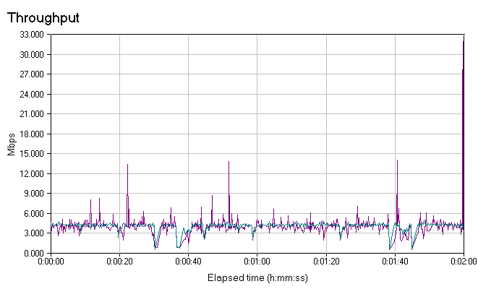
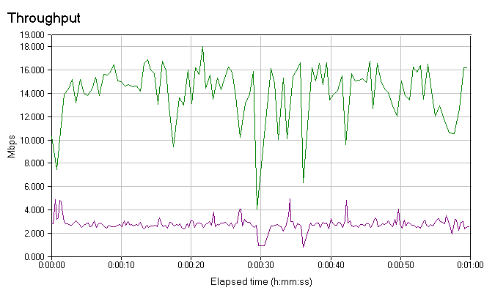
Real World Results
BEFORE
AFTER
Performance of both 802.11n and 802.11a stations without airtime fairness enabled
802.11a stations continue to operate at expected levels
802.11n stations experience much higher levels of throughput with airtime fairness enabled
Multi-rate testing with clients
  11n and 11a clients
  High data rate 11a and low data rate 11a clients
  High data rate 11n and low data rate 11n clients

Slide 53
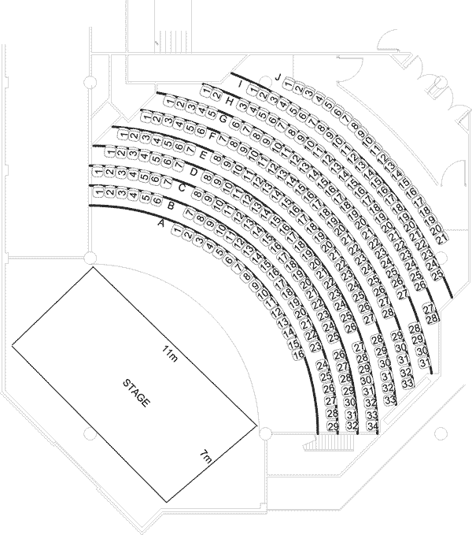




Dealing With Density
Before Band Steering
5GHz – 3 (18%)
2.4GHz – 14 (82%)
Band Steering for High Capacity Environments
Dual-band
802.11n
After Band Steering
5GHz – 14 (82%)
2.4GHz – 3 (18%)
Steers clients to 5GHz by withholding probe and auth responses on 2.4GHz
Does not steer clients below RSSI threshold set per WLAN
Client table in each AP tracks
  Client probe requests per band
  Avg. RSSI per band over last minute
  Dual band support
Table checked before responding to client
2.4 GHz
5 GHZ

Slide 54
ChannelFly
predictive capacity management technique
Maintains maximum network throughput
Quickly avoids interference from congested and noisy environments
Feature Summary
Continuously learns network capacity to evolve channel decision intelligence
Evaluates all channels, not just 1/6/11, by using them – no background scanning or guessing required
Fast reaction (in seconds) to significant drop in throughput
Wi-Fi Client friendly using 802.11h
Supports 2.4 GHz, 5 GHz and Mesh
…
Channel | 1 | 2 | 3 | 4 | 5
Observed throughput | 80 | 24 | 160 | 30 | 12
…
1
2
5
4
3

Slide 55
It’s All About Channel Capacity
2.4GHz RF CHANNEL
500
Competing approaches:
Go off channel
to listen only
Listen for beacons, frame errors, RF interference
Take a very small snapshot in time
Don’t provide a complete view of the entire spectrum
TIME
(miscroseconds)
0
OBSERVED THROUGHPUT (Mbps)

Slide 56
What does 802.11h do?
ChannelFly uses 802.11h channel change announcement
Coordinated channel changes w/out service interruption
  Change announced in advanced and synchronized with beacons
Clients
  Extremely fast change but does varies from chip to chip
  Packets buffered at AP, no loss
  Supported by all 5 GHz clients
  Supported by most 2.4 GHz clients (Apple, most Android, Qualcomm, Atheros, Broadcom, …)
Mesh
  Packets buffered so no packet loss as mesh tree is synchronized

Slide 57
Why Ruckus is Better at HD
Performance is dictated by channel usage
Adaptive antennas provides better control of the medium
  Fewer devices contending for the same channel
Maintaining higher data rates increases channel efficiency
It’s just physics

Slide 58
Questions
Lunch time

Slide 59
Tools & Mobile Apps
What to use and how to use it

Slide 60
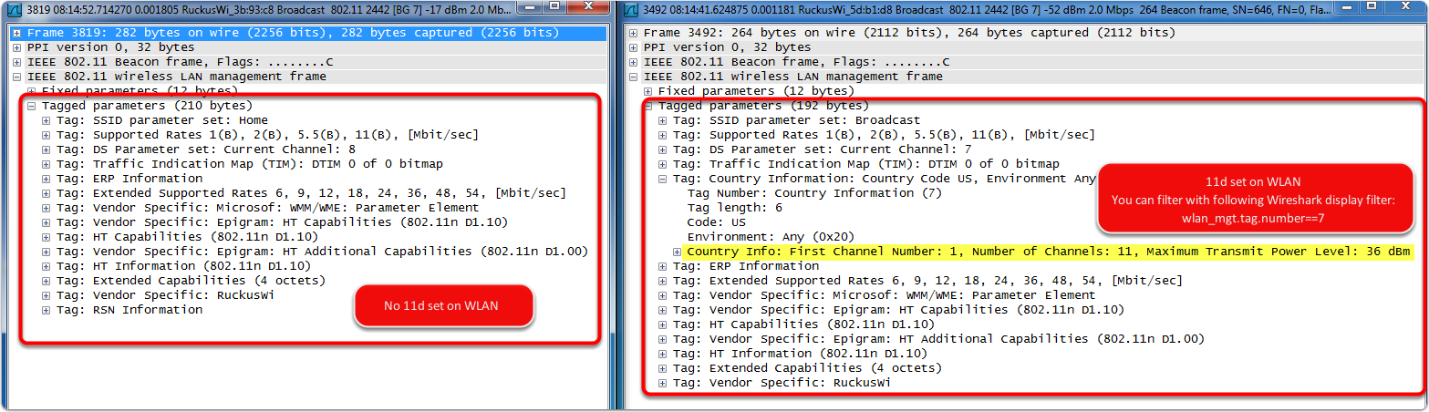
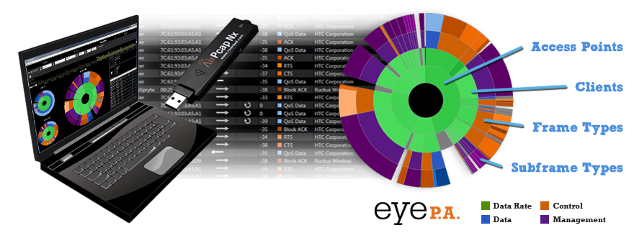
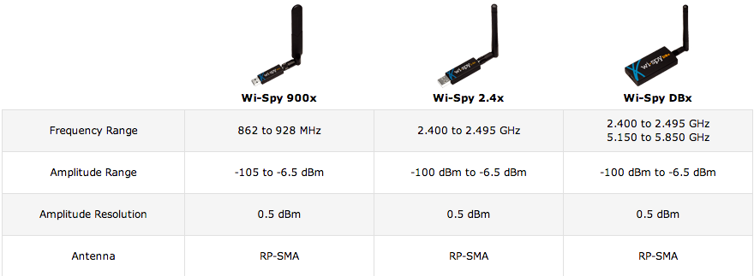
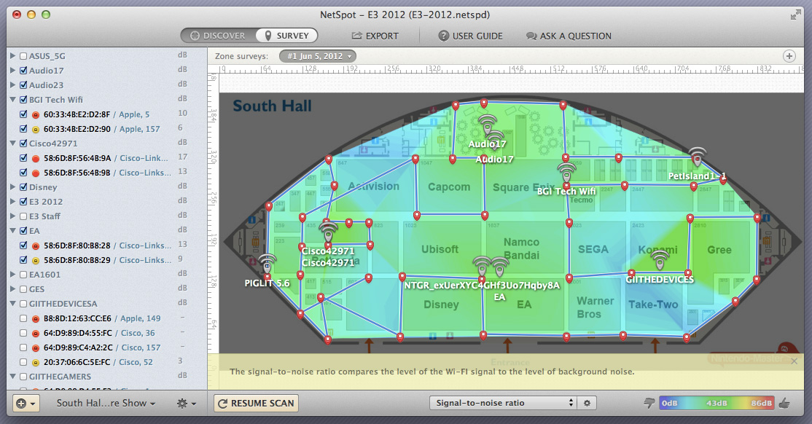
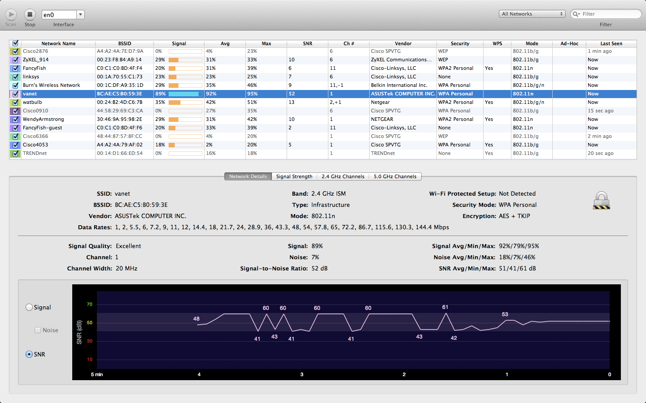
Tools
Wireshark
  Remote and local packet captures
Metageek
  Wi-Spy
  EyePA
  InSSIDer
NetSpot
  Discovery / Site Survey (basic, Mac only)
Wi-Fi Explorer
  Discovery tool (like InSSIDer for Mac)

Slide 61

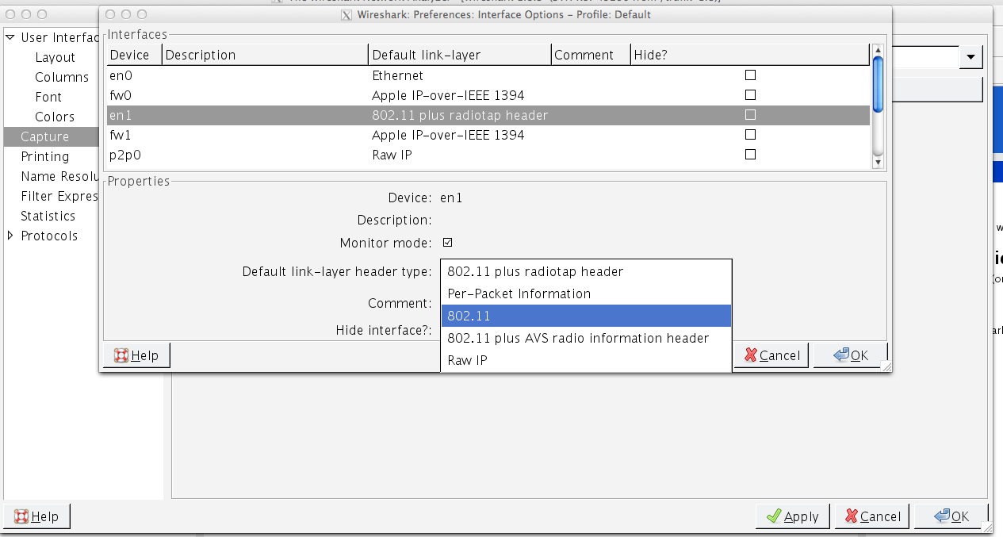
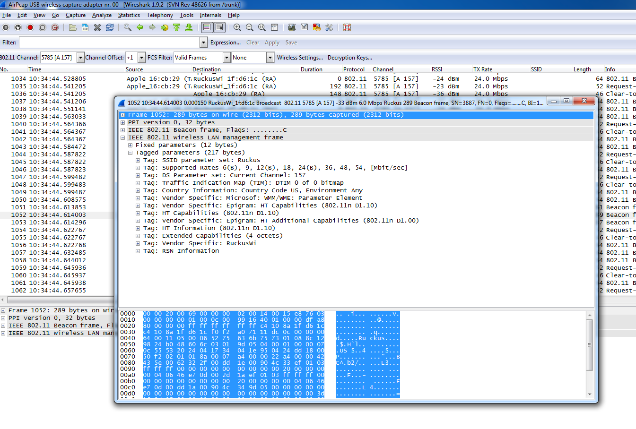

Wireshark
Capture natively on Mac
Go to Edit/Preferences/Capture
Select "enX" interface
Select "monitor mode"
In the "Default link-layer header type", select with ”Per-Packet Information” header.
Select "OK", then you can capture natively
Capture with AIRPCAP on Windows

Slide 62

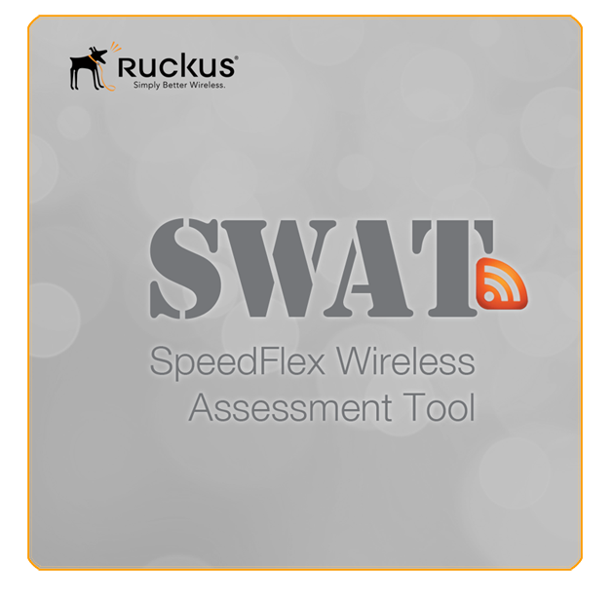


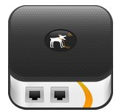
Mobile Apps
S.W.A.T. (SpeedFlex Wireless Assessment Tool)
  Site survey companion
SpeedFlex
  Mobile throughput test tool
Zapper
  Competitive and performance analysis tool (CDF generator)
ZoneDirector Remote
  Real time monitor of your ZD

Slide 63
S.W.A.T. for iOS and Android
Wireless performance testing
and site survey companion
Throughput based analysis
Project and survey creation
Import floor plans via popular cloud service Dropbox
Snap a quick photo with the built in iPad camera
Locate floor plan from photo gallery
Scale floor plan to make heat map more accurate
Choose from most common Ruckus APs
Test throughput by UDP/TCP, uplink and downlink
Generate email with throughput and/or heat map results
Upload heat map results to Dropbox
57%

Slide 64
SpeedFlex for iOS and Android
Real time mobile performance testing
Throughput based analysis
Instantly attach core location data to results (GPS)
Test throughput by TCP/UDP and UP/DOWN
Packet loss percentages
Generate email with results and location data

Slide 65
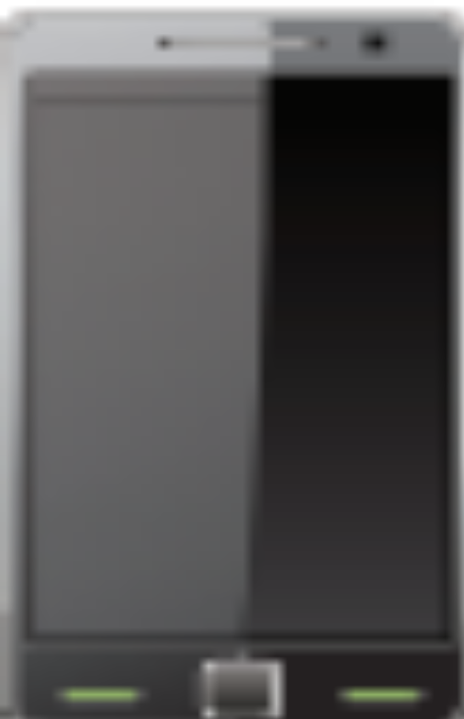


SpeedFlex (Android)
RSSI
Google Maps
Wi-Fi Channel
Frequency

Slide 66
Zapper (iPad)
Wi-Fi performance analysis tool
Perform real time throughput testing and instantly results graphed
Built on open source ZAP library
CDF (cumulative distribution function) shows identifiable metrics that indicate performance fluctuations
Allows product and competitive testing
Multiple tests with combined test view
Uplink or downlink testing
Email the results, including spreadsheet of results
Competitive comparisons, AP validations
or general site verification
18%
15%
10%
57%

Slide 67
ZD Remote (iPad)
Real time ZD monitoring capability
Real-time monitoring of Ruckus ZoneDirector
Provides dashboard view with easy to understand widgets such as
  System overview
  Device summary
  Usage statistics
  Currently active clients
  Client device types
  Live logs
A single or multiple ZoneDirectors can be administered via application
Select configuration controls (eg. WLANs)
coming soon
18%
15%
10%
57%

Slide 68


Spectrum Analyzer (coming late 2013)
iPad Spectrum Analyzer
18%
15%
10%
57%
FFT (instantaneous, and decaying max hold)
Spectrum CDF / Density (intensity of color shows how often a particular freq/power is observed)
Spectrogram (sometimes called waterfall, shows FFT over time, with color mapped to dBm)
Duty Cycle (by frequency, threshold is adjustable)

Slide 69
Questions

Slide 70
Beamforming vs. Adaptive Antennas
Whiteboard session
Hint: They aren’t the same!

Slide 71
Questions
Break

Slide 72
Packet Capture & Spectrum Analysis
Live Demo
Remote capture and ideas for troubleshooting

Slide 73
Questions

Slide 74
Beyond the Connection
BYOD and the Bonjour Gateway

Slide 75

Ruckus BYOD Solution
IDENTIFY
ONBOARD
  Application Recognition
  Client Fingerprinting
  On-boarding portal
    Guest Access
    Device Registration
  Mobile Friendly portal
  Customizable Portal Pages
MANAGE
SECURE
  D-PSK limits per user
  Extended Language Support
  Bonjour Gateway
  MDM
  Secure LDAP
  Application Policy Control
  Enhanced Roles

Slide 76

Key Technologies
Notes:
Overview presentation + detailed notes

Slide 77














What it Looks Like
WHAT HAPPENS WHEN?
User
Database
Student
Resources
Staff
Resources
Guest
Resources
1. Users connect to a provisioning SSID and are
re-directed to an onboarding portal.
Internet
Users enter domain credentials which are verified against a user database.
3. The user’s role assignment and permissions are automatically determined based on authentcaion.
4. Using Zero-IT, the device is auto-provisioned with a dynamic pre-shared key and dynamically assigned to the requisite WLAN.
Student SSID
Staff SSID
Guest SSID (hotspot)
Onboarding SSID
5. Devices re-connect on a secure WLAN, receiving network permissions according to their role.
Student
Staff
Guest
New BYOD Devices
Provisioned BYOD
Guest

Slide 78





Zero IT Automates Onboarding
Requirement: automatic, secure authentication and
roaming
Enabled by SSID and authorization protocol configuration
Easy-to-use Ruckus approach to push configuration
Uses mobile OS auto-detect and -authenticate features, not a separate connection manager app
Invitation
Branded
Landing
Page
‘One-Click’
Configuration
Automatic
Authentication Enabled
Notes:
Web

Slide 79





On-Boarding Portal
A modern day, mobile friendly, easy-to-use Wi-Fi connection option
Single SSID for Guest Access & BYOD Registration
BYOD SSID
(open)
Traditional Guest Access
Proceed to unencrypted
internet on BYOD SSID
Easy BYOD Registration
Move Client to
Secure SSID
Install Client Profile
DPSK/802.1x
Role based SSID
Limit DPSK generation per user

Slide 80




D-PSK Automates Security/Config
ZD applies role,
generates D-PSK
pushes dissolvable
PROV file to device
LDAP sends
user security group information to ZD
WLAN profile configured
device, and on the WLAN
based on allowed by role.

Slide 81



Client Fingerprinting
Hostname: Dave’s iPhone
    MAC: 50:ea:d6:7c:30:e4
Visibility “Who’s device is this?”
Self-registration
  Automatically registers and maintains client info on WLAN and Wired interfaces
    Operating System
    Operating System Hostname
Control by device type
  Permit/allow
  Assign to VLAN
  Rate limit (Down/Up)
Management
  WLAN controller or standalone
    WLAN dashboard
    Client monitor
    Client details
Notes:
Web

Slide 82




Device Specific Policy Enforcement
    Segregates trusted and untrusted devices on single SSID
    Simplified access rules per device
      ■ Windows  Windows Mobile
      ■ Mac OS  iOS
      ■ Linux  Android
      ■ VoIP  Gaming
      ■ Printers
    Control network access per device
    Permit/Deny
    Assign to VLAN
    Rate Limit (Down/Up)
✖
VLAN 20
VLAN 10
Device Policy Access Control
Device Type | Access | VLAN | Rate Limit DL|UL
Gaming | Deny | - | -
Windows, Mac OS, Linux | Permit | 20 | -
iOS, Windows Mobile, Android | Permit | 10 | 4 Mb | 1 Mb

Slide 83









Bonjour Gateway – In Phases
Bridging
9.8
Fencing*
9.7
Filtering
Printing
Teacher
VLAN
FileSharing
AP Fencing
9.8
9.7
Bridging
Filtering
Student
VLAN
ZD must see all VLAN traffic to provide bridging services.

Slide 84




Bonjour Gateway
Demo overview
ZoneDirector and AP setup
Deployment Considerations
Caveats and Limitations
  ZD must be trunked with direct access to all bridged Bonjour services/VLANs
  SSIDs must have static access VLANs (no dynamic VLAN support)
Router
DHCP Server
VLAN 110, 120
ZoneDirector
Trunk Port
VLAN 110, 120
L2 Switch
VLAN
SSID: Student
VLAN: 120
SSID: Staff
VLAN: 110

Slide 85
Questions

Slide 86
Competitive

Slide 87

Independent test results
AVG. TCP THROUGHPUT
20
18
16
14
12
10
8
6
4
2
0
Highest, most reliable performance
Ruckus 7982
Cisco 2602i
HP 430
Cisco 3602i
Xirrus 4820
Aruba 135
Juniper 532
Aerohive
AP330
HP 460
Aruba 105
Meraki MR24
Aerohive AP121
Meraki MR16
Linksys EA4500
Ubiquiti UniFi Pro
Lowest, least reliable performance
20
30
40
50
60
70
80
VIDEO ERRORS
WI-FI STRESS TEST

Slide 88






Independent test results
Industry’s First 3x3:3 802.11n Competitive Testing
6%
2%
12%
14%
66%
Percentage of Vendor Test Wins
(87 tests)

Slide 89
Ruckus Labs
Who is here, What is here, examples.

Slide 90
Who is here
Marcus Burton
Chandan Argawal
Jim Stewart
Jeanette Lee
Deepak Sant
Dave Wright

Slide 91
What is here
Ruckus internal test bed
  Performance
  Interoperability
  Competitive
  Best practices
15,000 sq. foot facility
Office park/office environment
  Outdoor testing up to 300m (1,000’) LoS
  300+ Wi-Fi devices … and growing!
  iPads, Phones, laptops, tablets (wide range for testing)

Slide 92
Questions

Slide 93
New Products and Features

Slide 94

Release 9.6
Products
  ZoneFlex 7055 Wall Switch AP
Wireless and Network
  Onboarding Portal (BYOD + Guest Access)
  Per user D-PSK limits
  USB Backhaul “Our-Fi”
  Spectrum Analysis
  Ethernet Jumbo frame support for 7782
  54 SSID per Access Point (27 per radio)
  Tunnel QoS Config (static, copy from packet)
GA – April 2013
Management
  Syslog Enhancements (Config facility, Add Severity)
  Alarms, Email, Traps sent after reboot
  ZD Ethernet Port Status (GUI, CLI, SNMP, FM)
  FlexMaster Vmware support and Virtual Image distribution
  FlexMaster CentOS support

Slide 95


Introducing ZoneFlex 7055
Industry’s first dual-band concurrent 2-stream wall-plate AP
802.11a/b/g/n, dual-band concurrent 2x2:2
600 Mbps theoretical PHY rate
Gigabit Ethernet Uplink with PoE input (802.3af/at)
Supports SmartMesh Networking
Universal form factor & mounting bracket mounts to worldwide standard utility wall-boxes
Torx screw security against opportunistic theft
(4) 10/100 Ethernet Ports
(1) 802.3af PoE output
Pass-through support
Support ZD/FM 9.6, SCG 2.1
Now Shipping with 9.6 LCS Support

Slide 96








SmartPoint USB Backhaul
Carrier Class Mi-Fi
Utilize USB interface on AP for network backhaul
    3G/LTE/WiMax
Backhaul for Mesh & Ethernet
Monetize Spectrum
Quick & Easy Deployments
Requires special order AP (USB + Filters)
Purchased Spectrum: 3G/LTE/WiMax
LWAPP/GRE Tunnel
ZD/SCG
Carrier Network
AP
USB Dongle
Hot Spot/3G/LTE by Carrier or Mobile Operator
Carrier Network
Retail, Restaurant, Business Kiosk, Temporary Networks

Slide 97







Spectrum Analysis
Real-time spectral analysis
  ZD GUI
  Hi-Res iPad App (2H 2013)
Visualize and investigate interference from Wi-Fi and non-WiFi sources.
Remotely accessible via network
Available on:
  7055, 7321, 7352, 7372,7982, 7782, 8800
ZD GUI
Visualize & Investigate
Sources of Wi-Fi & non Wi-Fi interference
iPad App

Slide 98
Release 9.7
Beta – May 2013
LCS – June 2013
GA – July 2013
Wireless and Network
  WIPS Enhancements (Manual Contain, Signal Strength, OID of Rogue, Display Malicious Only)
  SmartClient single redirection support
  Force DHCP on WLAN
  Bonjour Gateway
  AP Survivability for New Associations with Open/WEP/PSK
  Full L2 Client Isolation
  Ekahau BLINK support
Management
  Channel Fly Memory/Reset
  DHCP for Smart Redundancy
  Polycom Compatibility auto-config

Slide 99


WIPS Enhancements
Show RSSI of top 5 reporting Access Points
Manual Containment & Display of “user-blocked” devices
Limit rogue reporting by Malicious Rogue type
  Event-log, SNMP trap, syslog, e-mail
Filter GUI by malicious only
Limit Rogue Reporting
Detecting AP with signal strength
Manually Contain
Filter GUI by malicious type only

Slide 100

AP Survivability
Enables existing and new client connectivity when ZoneDirector is offline
New Autonomous WLAN
  Auth type: open
  Encryption type:
    WPA, WPA2, WPA-Mixed, WEP-64, WEP-128, None
No Tunnel Support
ZD GUI/CLI support

Slide 101

ZoneFlex R700
Phase 1 802.11ac Indoor Access Point
802.11a/b/g/n/ac 3x3:3 Concurrent Dual-Band
  802.11b/g/n 2.4 GHz radio → 450 Mbps theoretical PHY
  802.11a/n/ac 5 GHz radio → 1,300 Mbps theoretical PHY
BeamFlex adaptive antennas
  21 switchable elements provide 3,000+ unique patterns
  Dual polarity
2x Gigabit Ethernet Ports
Powered by 802.3af/at or 12VDC wall adapter
Dimensions: 15.8 x 15.8 x 4 cm (7982 form-factor)
Availability (plan of intent)
Shipping 2H 2013

Slide 102
Questions

